Slide 1
Introducing Machine Learning
Machine Learning (ML) is a transformative technology that enables systems to learn from data, identify patterns, and make decisions with minimal human intervention. This document aims to provide an overview of machine learning, its types, applications, and the underlying principles that make it a powerful tool in various fields. As we delve into the world of machine learning, we will explore its significance in today’s data-driven landscape and how it continues to shape the future of technology.
Notes:
Machine learning is a way for computers to learn from data and make decisions without being directly programmed. It's like teaching a computer to recognize patterns so it can solve problems on its own.
For example, if you show a machine lots of pictures of cats and dogs, it can learn the difference and tell you which is which, even for new pictures it hasn't seen before.
It’s used in many everyday things like:
Voice assistants (like Siri or Alexa)
Movie recommendations (like on Netflix)
Spam filters in email
So, machine learning helps computers get smarter by learning from experience, just like people do.

Slide 2
What is Machine Learning?
Machine Learning is a subset of artificial intelligence (AI) that focuses on the development of algorithms that allow computers to learn from and make predictions based on data.
Unlike traditional programming, where explicit instructions are given, ML algorithms improve their performance as they are exposed to more data over time.
Notes:
Machine Learning (ML) is a branch of artificial intelligence (AI) that focuses on creating systems that can learn from data and improve over time without being explicitly programmed.
In simple terms:
Machine learning is about teaching computers to learn from examples and make decisions or predictions based on that learning.

Slide 3

Machine Learning Hierarchy
Machine Learning
Algorithms learning from data
1
Artificial Intelligence
Broad field of intelligent systems
2
Data
Foundation for learning and prediction
3
Notes:
Machine Learning
├── Supervised Learning
│ ├── Classification
│ └── Regression
├── Unsupervised Learning
│ ├── Clustering
│ └── Dimensionality Reduction
└── Reinforcement Learning

Slide 4
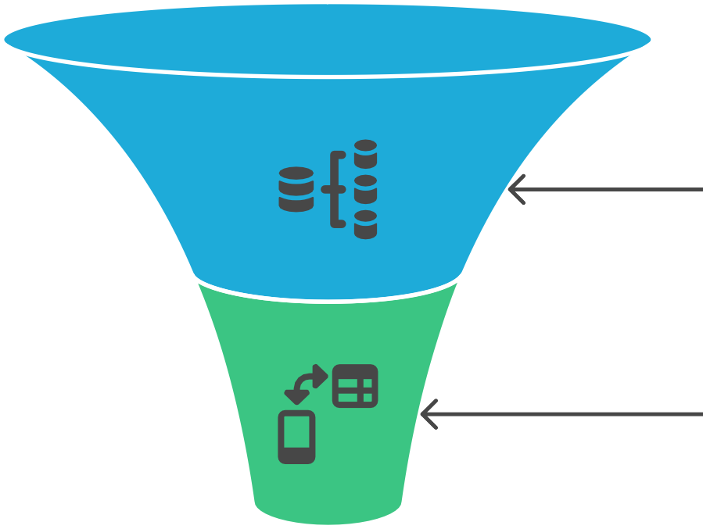
Supervised Learning Process
Labeled Dataset
Model Training
Prediction Making
Accurate Predictions
Notes:
Machine learning can be broadly categorized into three types:
1. Supervised Learning: In this approach, the model is trained on a labeled dataset, meaning that the input data is paired with the correct output. The model learns to map inputs to outputs and can make predictions on new, unseen data. Common applications include classification and regression tasks.

Slide 5



Unsupervised Learning Tasks
Dimensionality Reduction
Reducing data complexity while preserving information
Clustering
Grouping data points into clusters
Unsupervised Learning
Core concept of learning from unlabeled data
Notes:
. Unsupervised Learning: Here, the model is trained on data without labeled responses. The goal is to identify patterns or groupings within the data. Clustering and dimensionality reduction are typical tasks in unsupervised learning.

Slide 6
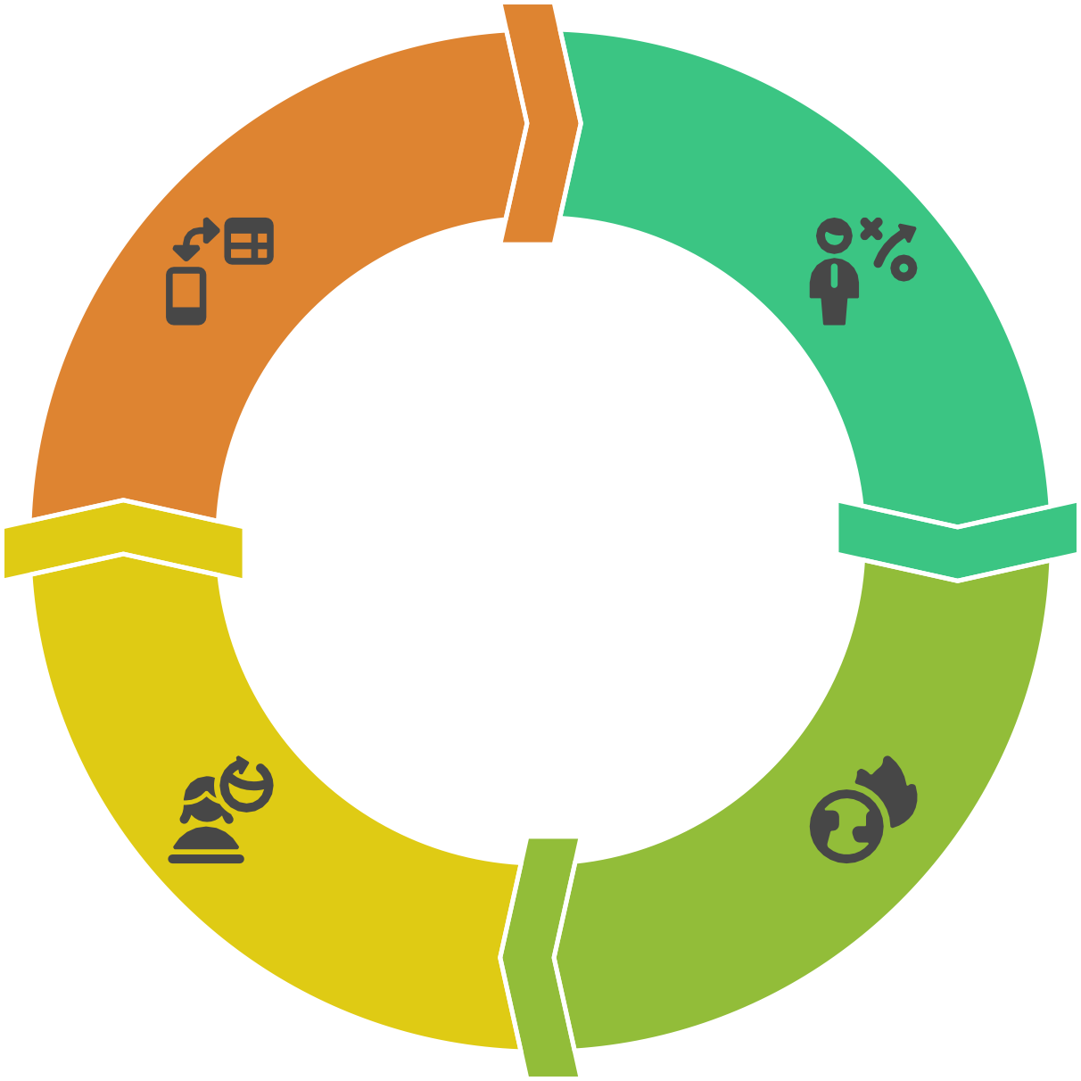
Reinforcement Learning Cycle
Agent Takes Action
The agent initiates an action in the environment.
Agent Learns
The agent updates its strategy based on
feedback.
Agent Receives
Feedback
The agent gets feedback on its action.
Environment Responds
The environment reacts to the agent's action.
Notes:
. Reinforcement Learning: This type involves training an agent to make decisions by taking actions in an environment to maximize cumulative rewards. The agent learns through trial and error, receiving feedback based on its actions. This approach is widely used in robotics, gaming, and autonomous systems.

Slide 7
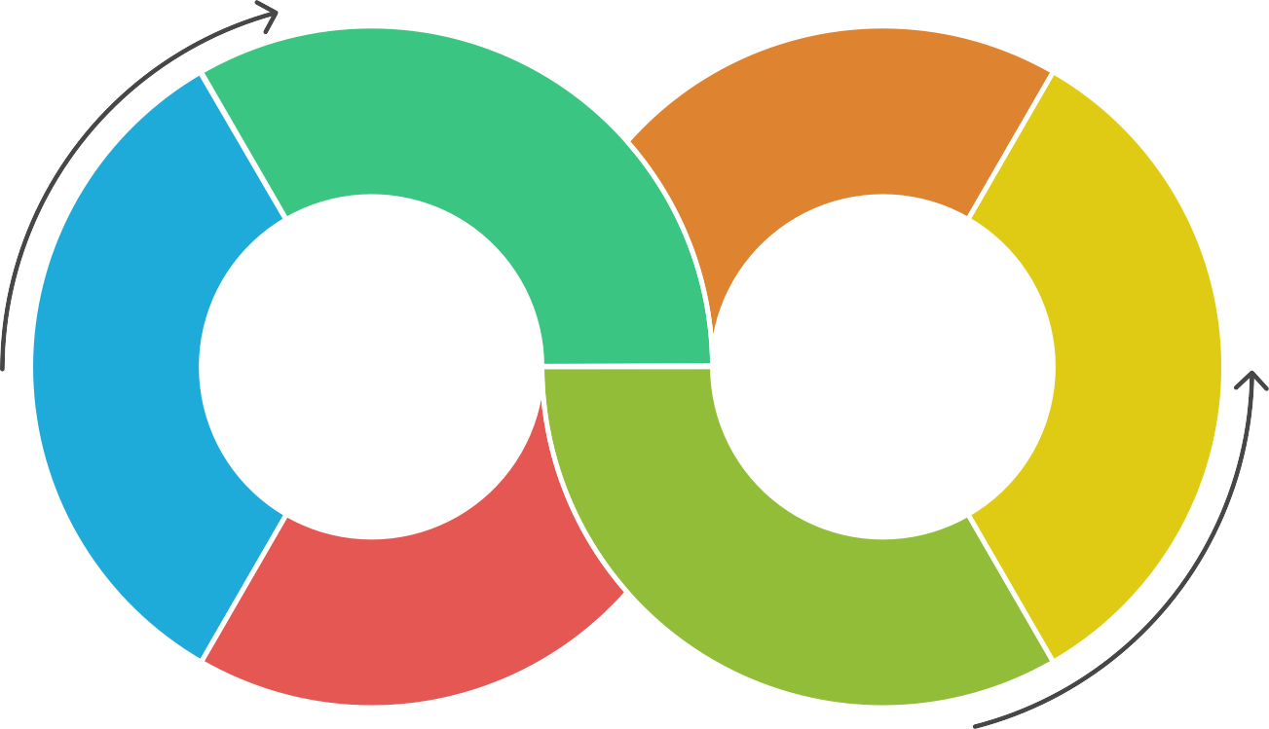
The Machine Learning Cycle
Apply Knowledge
Implement machine learning techniques in real- world scenarios.
Make Informed Decisions
Utilize data-driven insights for better decision-making.
2
5
Understand Principles
Grasp the foundational concepts of machine
learning.
Enhance Efficiency
Improve processes and outcomes using machine learning.
1
4
6
3
Create Smarter Systems
Develop intelligent systems that adapt and learn.
Drive Innovation
Foster new ideas and solutions through machine learning.
Notes:
Machine Learning Cycle (Simple Explanation)
Ask a Question (Problem)
What do you want the computer to learn or predict?
Example: Can it tell if a photo is of a cat or a dog?
Collect Data
Gather examples to learn from.
Example: Lots of photos of cats and dogs.
Clean the Data
Fix mistakes and get the data ready.
Remove bad or missing info.
Pick the Important Info (Features)
Choose what parts of the data will help the computer learn best.
Example: Shape of ears, color, size, etc.
Choose a Model
Pick a method to teach the computer.
Like choosing a recipe to follow.
Train the Model
Let the computer learn from the examples.
Test the Model
See how well it learned by giving it new data.
Did it guess right?
Improve It
Make changes to get better results.
Try different settings or more data.
Use It (Deploy the Model)
Put it to work in the real world.
Now it can recognize new cat or dog photos.
Watch and Update
Keep checking if it’s still working well.
Update it with new data if needed.

Slide 8

The Resurgence of Machine Learning
Early 2000s
Availability of large datasets
Late 1990s
Increase in computational power
Early 2000s
Advancements in algorithms
Notes:
AI had a slow start but made a big comeback. Today, it's growing faster than ever and becoming a key part of our daily lives.
The AI Winter (1970s–1990s) - People lost interest because AI wasn’t working as well as promised.
Computers were too slow, and there wasn’t enough data.
🔥 The Comeback (1990s–2000s)
Machine learning became popular - AI started working in real life: email spam filters, search engines, etc.
🚀 Massive Growth (2010s–Now) -Deep learning changed everything: computers started recognizing faces, understanding speech, translating languages.
Big tech companies (Google, Amazon, Microsoft, etc.) invested heavily in AI.
Smartphones, voice assistants, smart cars – all powered by AI.
📈 Today’s Boom (2020s)

Slide 9
The Rise of Deep Learning in the 2010s
2010s
Success in image and speech recognition
2010s
Advent of deep learning
2010s
Contributions by Hinton, LeCun, and Bengio
2010s
Impact on NLP and autonomous vehicles
Notes:
What is Deep Learning?
Deep learning is a special kind of machine learning where the computer uses something called a neural network — it’s like a mini version of how the human brain works.
It helps machines learn from lots of data — especially things like images, speech, and language — and make smart decisions.

Slide 10
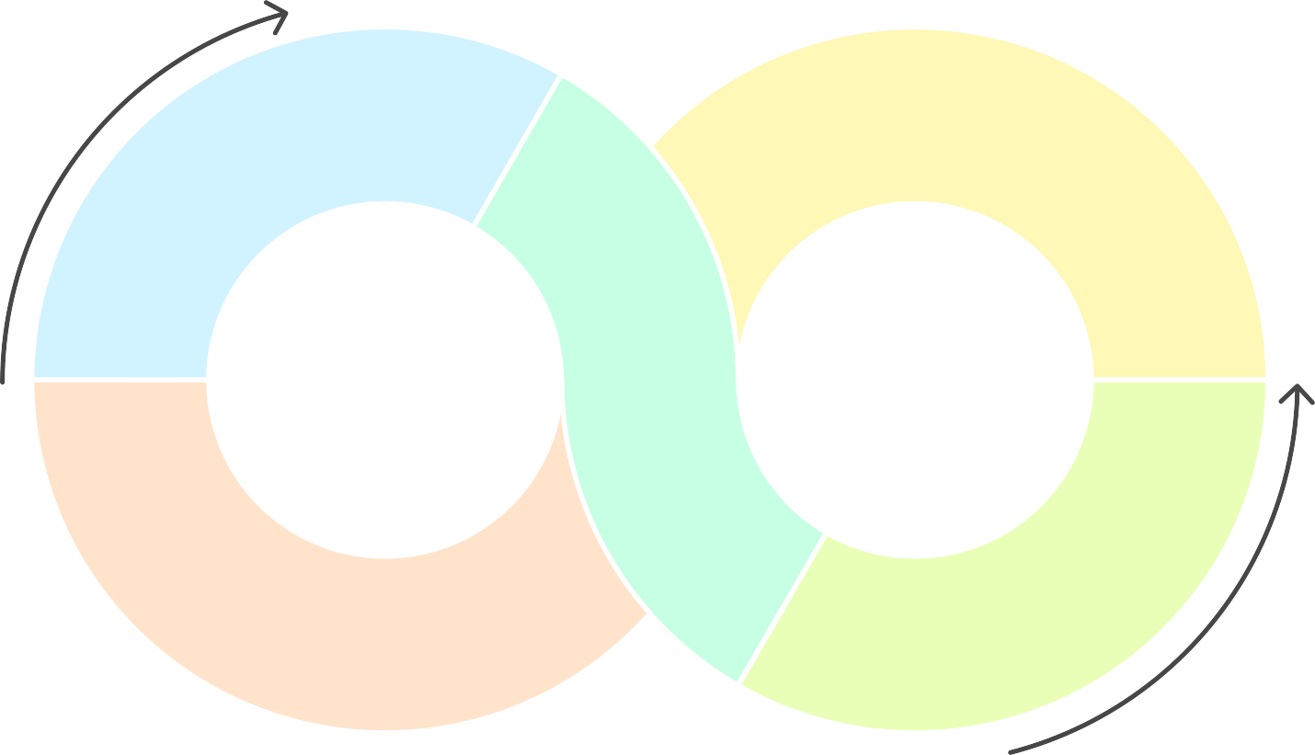
The Cycle of Machine Learning Applications
Data Analysis
Analyzing data to gain insights
Accuracy Improvement
Refining predictions and results
1
4
2
Innovation
Drive
Fostering new ideas
and solutions
Efficiency Enhancement
Improving processes and outcomes
5
3
Decision Making
Using insights to make informed decisions
Notes:
Identify a Problem
Ask: What do we want the machine to do?
Example: Can it detect fake news? Predict house prices? Recommend movies?
Collect Data
Gather real-world examples.
Example: News articles, house features, or users’ movie ratings.
Prepare the Data
Clean the data: fix errors, remove duplicates, fill in missing parts.
Turn it into a format the machine can understand.
Train a Model
Let the machine learn from the data.
It starts recognizing patterns or rules.
Test the Model
Try it on new (unseen) data to see if it works well.
Example: Does it correctly guess if a news article is fake?
Improve the Model
Make changes to get better results.
Add more data, try new settings, or pick a better method.
Use the Model (Deploy)
Put it to work in a real app or system.
Now it's making predictions or decisions for users.
Monitor and Update
Keep checking if it’s still working well.
If things change, retrain it with new data.

Slide 11
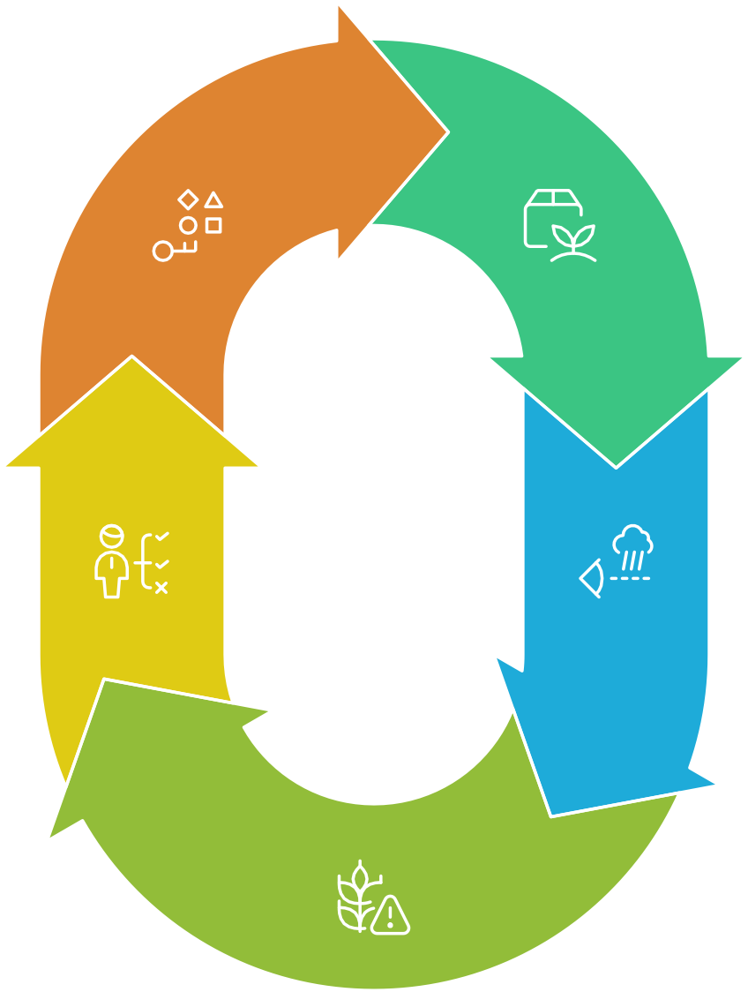
Machine Learning in Agriculture Cycle
Allocate Resources
Efficient distribution of water and fertilizers.
Analyze Soil Data
Farmers use ML to understand soil composition.
Make Informed Decisions
Farmers use insights to optimize planting.
Monitor Weather Patterns
ML helps predict weather impacts on crops.
Assess Crop Health
ML identifies potential health issues in crops.
Notes:
Machine learning is transforming agriculture by enabling precision farming, crop monitoring, and yield prediction. Farmers can use ML algorithms to analyze soil data, weather patterns, and crop health, leading to more informed decisions about planting

Slide 12

Machine Learning in Cybersecurity
Overall protection of digital assets
Cybersecurity
Analyzes data for suspicious activities
Network Traffic Analysis
Swift action against potential breaches
Real-time Response
Identifies unusual network patterns
Threat Detection
Machine Learning
Core technology for threat detection
Notes:
Machine learning plays a crucial role in cybersecurity by detecting and responding to threats in real-time. ML algorithms can analyze network traffic and identify unusual patterns that may indicate a cyber attack, allowing organizations to respond

Slide 13

How Do Machines Learn
Machine Learning
Core concept of learning from data
1
Techniques
Methods used in machine learning
2
Processes
Steps in the learning process
3
Insights
Understanding gained from data
4
5
Applications
Real-world uses of machine learning
Notes:
They Get Examples
Just like we learn by seeing and practicing, machines learn by looking at lots of examples.
Example: Show a computer many pictures of cats and dogs, labeled correctly.
They Find Patterns
The machine looks for things that are common in each group.
Like cats usually have pointy ears, dogs might have floppy ears.
They Make Rules
From the patterns, the machine creates its own rules.
For example, “If it has pointy ears and whiskers, it’s probably a cat.”
They Test Themselves
The machine tries to guess the answer for new examples it hasn’t seen before.
It checks if it’s right or wrong.
They Learn From Mistakes
If the machine guesses wrong, it adjusts the rules to do better next time.
It keeps practicing and improving.

Slide 14













Data Collection Process for Machine Learning
Data Quality Check
Ensuring data accuracy and reliability
Data Quantity Assessment
Evaluating the volume of data collected
Data Gathering
Collecting data from various sources
Notes:
Collecting good data means knowing what you need, finding it, checking it, labeling it, and organizing it so machines can learn well.
Understand What You Need
Decide what kind of data will help solve your problem.
Example: For recognizing cats, you need lots of cat pictures.
Find the Data
Collect data from different places:
Websites, sensors, surveys, databases, or apps.
Example: Download cat photos from the internet.
Check the Data Quality
Make sure the data is good and useful.
Remove wrong or low-quality examples.
Example: Remove blurry or unrelated photos.
Label the Data (If Needed)
Add information to explain what each data point means.
Example: Mark photos as “cat” or “not cat.”
Store the Data
Keep the data safe and organized for easy access.
Use files, databases, or cloud storage.
Prepare for Use
Clean the data to fix missing parts or errors.
Format it so the machine can understand.

Slide 15
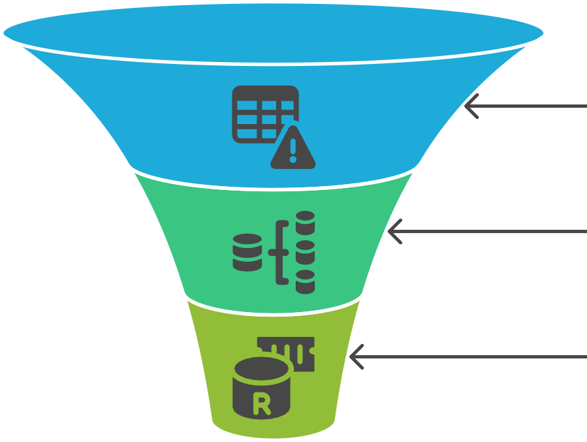
Data Preprocessing Funnel
Raw Data
Handle Missing Values
Normalize Data
Encode Categorical Variables
Processed Data
Notes:
Data Preprocessing Funnel (Simple Words)
Collect Raw Data
Get the data from different sources.
This data is usually messy and unorganized.
Clean the Data
Fix or remove bad parts like:
Missing values (empty spots)
Wrong or inconsistent information
Duplicate entries
Transform the Data
Change the data into a better format for the machine.
Examples:
Convert words to numbers
Scale values so they’re similar sizes
Normalize data (make it consistent)
Feature Selection
Pick the most important parts (features) that help the model learn.
Remove irrelevant or noisy information.
Split the Data
Divide data into parts:
Training set (to teach the model)
Testing set (to check how well it learned)

Slide 16
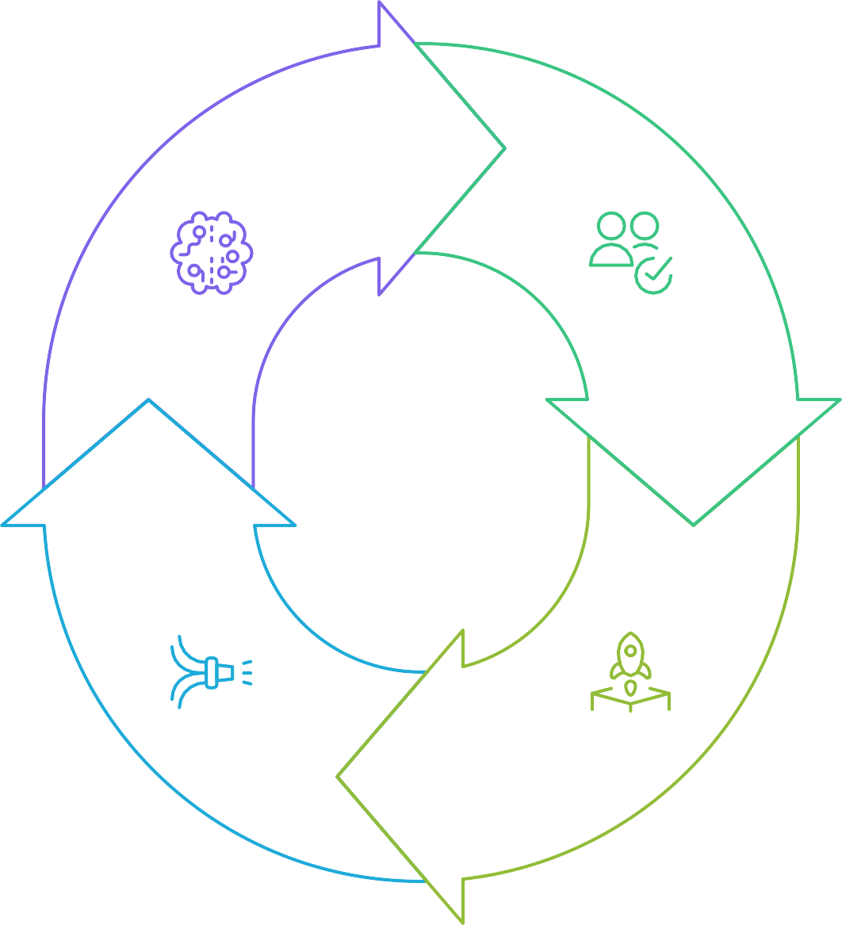
Machine Learning Deployment Cycle
Retrain Model
Improve the model with new data.
Validate Model
Ensure the model performs well on new data.
Gather New Data
Collect data from real-world
use.
Deploy Model
Implement the model in real-world applications.
Notes:
Build the Model
Train the machine learning model using data.
Example: Teach it to recognize cats in photos.
Test the Model
Check if it works well on new data it hasn’t seen.
Make sure it’s accurate and reliable.
Deploy the Model
Put the model into a real app or system.
Now it can start making predictions for users.
Monitor the Model
Keep an eye on how well it performs in real life.
Watch for mistakes or changes in data.
Update the Model
If performance drops or data changes, retrain or improve the model.
Keep it up-to-date and accurate.

Slide 17
Data abstraction in ML
Pros
Cons
Enhanced generalization
Potential information loss
Contextual understanding
Increased complexity
Efficient processing
Notes:
Pros (Advantages)
Simplifies Data
Focuses on important features and ignores unnecessary details.
Makes it easier for the model to learn.
Reduces Noise
Removes irrelevant or confusing information.
Helps improve model accuracy.
Speeds Up Learning
Less data to process means faster training and prediction.
Improves Generalization
Helps the model perform better on new, unseen data by focusing on core features.
❌ Cons (Disadvantages)
Loss of Information
Important details might be accidentally removed.
Can lead to poorer performance if too much is abstracted.
Requires Expertise
Choosing what to keep or remove needs good understanding of the data and problem.
May Oversimplify
Too much abstraction can make the data too simple, missing complex patterns.
Additional Step
Adds extra work in preparing data before training.
In Short:
Data abstraction helps make machine learning easier and faster by focusing on key information — but it needs to be done carefully to avoid losing important details

Slide 18
Generalization in Machine Learning
Real-World Application
Generalization
Model Development Training Data
Notes:
Generalization means how well a machine learning model can make good predictions on new, unseen data, not just the examples it was trained on.
Understanding generalization is crucial for developing robust machine learning models that can effectively solve real-world problems.

Slide 19

Factors Affecting Generalization
1
Balances intricate patterns with overfitting risks.
Model Complexity
Larger datasets improve representation and generalization.
Training Data Size
Improved Generalization
2
Relevant features prevent overfitting and enhance generalization.
Feature Selection
3
Notes:
Factors Affecting Generalization in Machine Learning
Amount of Training Data
More good-quality data helps the model learn better and generalize well.
Too little data makes the model guess based on limited info.
Quality of Data
Clean, accurate, and relevant data helps the model learn true patterns.
Noisy or wrong data confuses the model.
Model Complexity
A simple model may not learn enough (underfitting).
A very complex model may learn too much detail and noise (overfitting).
Finding the right balance is key.
Feature Selection
Using the right important features helps the model focus on what matters.
Irrelevant features can mislead the model.
Training Time
Training too little means the model hasn’t learned enough.
Training too much can cause the model to memorize the data, hurting generalization.
Regularization
Techniques that help prevent overfitting, like limiting how complex the model can get.
Data Diversity
Training data should represent all the different types of situations the model will see later.

Slide 20
Enhancing Model Generalization
Initial Model Training
Cross-Validation
Regularization Data Augmentation Early Stopping
Improved Model Generalization
Notes:
Cross-Validation: This technique involves partitioning the training data into subsets to validate the model's performance on different data splits, helping to ensure that the model generalizes well.
Regularization: Techniques such as L1 and L2 regularization add a penalty for
complexity to the loss function, discouraging overfitting and promoting simpler models.
Data Augmentation: By artificially increasing the size of the training dataset through
transformations (like rotation, scaling, or flipping), models can learn to generalize better.
Early Stopping: Monitoring the model's performance on a validation set during
training and stopping when performance begins to degrade can prevent overfitting.

Slide 21
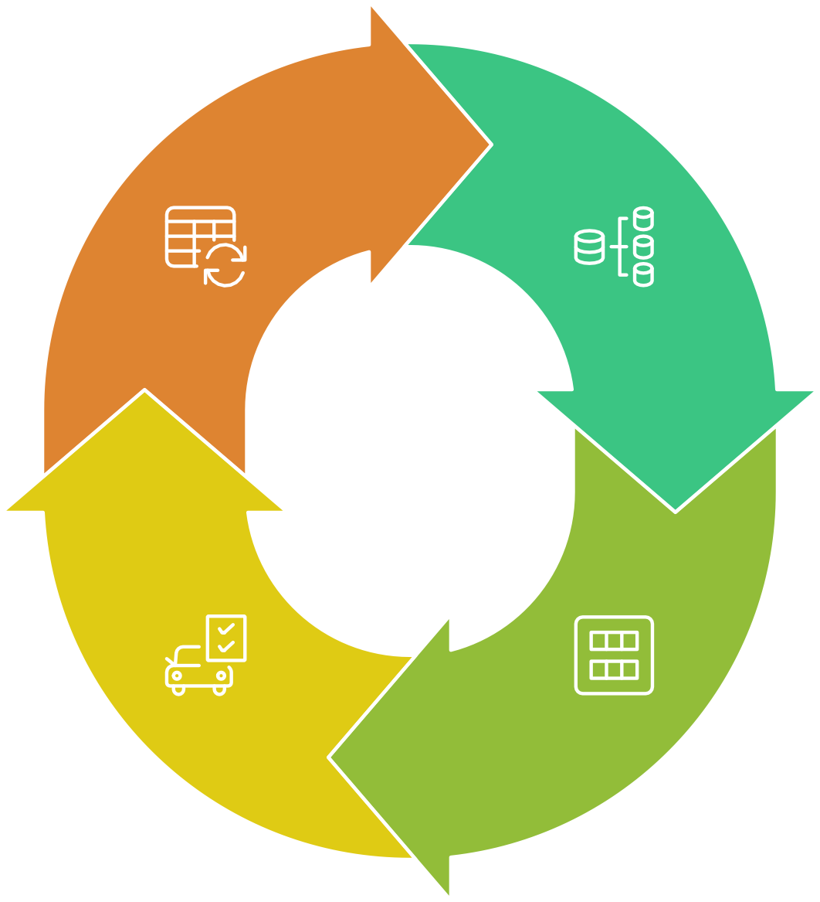
Cross-Validation Cycle
Iterate Process
Repeat the process with different subsets
Partition Data
Divide the dataset into subsets
Test Model
Evaluate the model on
testing subsets
Train Model
Train the model on training subsets
Notes:
Cross-validation is like testing your model many times on different slices of data to make sure it works well everywhere.

Slide 22

Steps to Apply Machine Learning to Your Data
In this document, we will outline the essential steps to effectively apply machine learning techniques to your data. Whether you are a beginner or have some experience, this guide will help you navigate the process from data collection to model deployment. By following these steps, you can harness the power of machine learning to derive insights and make predictions from your data.

Slide 23

Machine Learning Problem Definition
Various advanced machine learning tasks
Other ML Problems
Grouping similar data points together
Clustering
Predicting continuous numerical values
Regression
Categorizing data into predefined classes
Classification
Problem Definition
Clearly defining the objective
Notes:
Before diving into data, it's crucial to clearly define the problem you want to solve. Determine whether it is a classification, regression, clustering, or another type of machine learning problem. Understanding the objective will guide your data collection and model selection.

Slide 24




Data Collection Process for Machine Learning
Identify Relevant Data
Determine data pertinent to the problem
Ensure Data Quality
Verify data accuracy and completeness
Assess Data Quantity
Evaluate if data is sufficient for training
Collect Data
Gather data from identified sources
Notes:
Gather the necessary data that is relevant to your problem. This data can come from various sources such as databases, APIs, web scraping, or public datasets. Ensure that the data is sufficient in quantity and quality to train a robust model.

Slide 25
Data Preprocessing Funnel
Raw Data
Data Cleaning
Data Transformation
Feature Selection
Refined Data
Notes:
Once you have collected the data, the next step is preprocessing. This includes:
Cleaning: Remove duplicates, handle missing values, and correct inconsistencies.
Transformation: Normalize or standardize numerical features, and encode categorical variables.
Feature Selection: Identify and select the most relevant features that contribute to
the model's performance.

Slide 26



Data Split for Machine Learning
70%
15%
15%
Training Set
Validation Set
Test Set
Notes:
Divide your dataset into training, validation, and test sets. A common split is 70% for training, 15% for validation, and 15% for testing. This ensures that you can evaluate the model's performance on unseen data.

Slide 27










Which machine learning algorithm should be chosen?
Regression
Ideal for predicting continuous numerical values.
Classification
Suitable for categorizing data into distinct classes.
Clustering
Best for grouping similar data points together.
Notes:
Choose a Model
Select an appropriate machine learning algorithm based on the problem type and the nature of your data. Common algorithms include:
Classification: Logistic Regression, Decision Trees, Random Forest, Support Vector Machines.
Regression: Linear Regression, Decision Trees, Random Forest, Gradient Boosting.
Clustering: K-Means, Hierarchical Clustering, DBSCAN.

Slide 28

Model Training Process
Fit Model
Minimize Error
Monitor Overfitting
Notes:
Train the Model
Use the training data to teach the model how to make predictions.

Slide 29
Model Performance Evaluation and Refinement
Model Evaluation
Metric Selection
Performance Measurement Hyperparameter Adjustment
Improved Model Performance
Notes:
Validate the Model
Evaluate the model's performance using the validation dataset. Use metrics such as accuracy, precision, recall, F1 score for classification tasks, and mean squared error or R-squared for regression tasks. Adjust hyperparameters as necessary to improve

Slide 30

Model Testing Cycle
Validate Model
Assess performance on
validation set
Evaluate Generalization
Determine ability to handle new data
1
2
3
Test Model
Evaluate on test dataset
Notes:
Test the Model
Once you are satisfied with the model's performance on the validation set, test it on the test dataset. This provides an unbiased evaluation of the model's ability to generalize to new data.

Slide 31
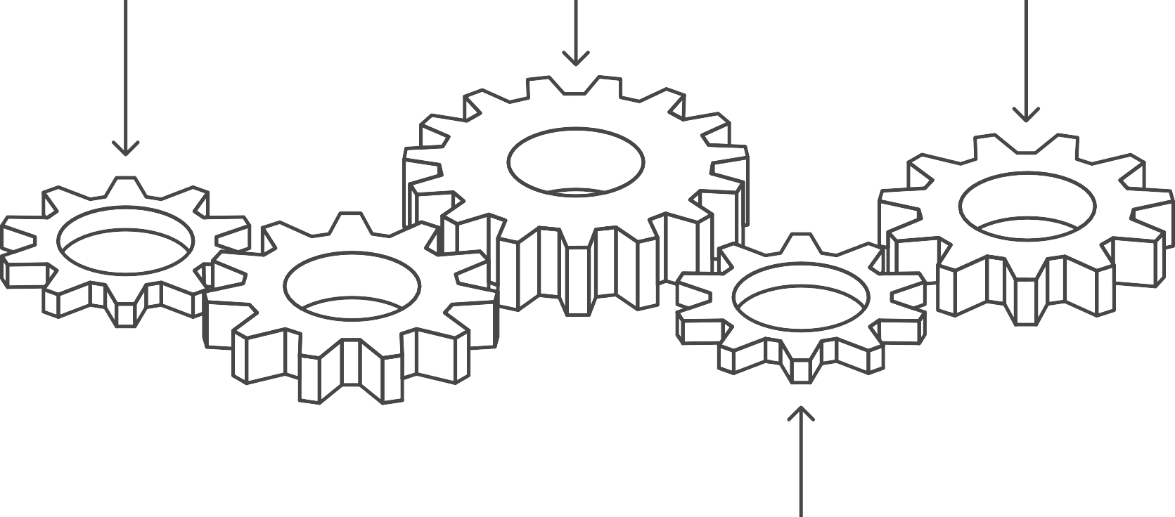



Model Deployment Process
Integrate into Application
Test the Model
Make Predictions
Deploy to Production
Set up API
Notes:
Deploy the Model
After testing, deploy the model into a production environment where it can be used to make predictions on new data. This may involve integrating the model into an application or setting up an API

Slide 32





Model Monitoring and Maintenance Cycle
Monitor Performance
Track model accuracy and relevance
Update Model
Adjust based on data changes
Retrain Model
Update the model with new data
Collect New Data
Gather updated datasets for retraining
Notes:
Monitor and Maintain the Model
Continuously monitor the model's performance over time. As new data becomes available, retrain the model to ensure it remains accurate and relevant. Be prepared to update the model as necessary based on changes in data patterns or business requirements.
By following these steps, you can effectively apply machine learning techniques to your data, enabling you to extract valuable insights and make informed decisions.

Slide 33
Choosing a Machine Learning Algorithm
Understanding the Problem Type
In the rapidly evolving field of machine learning, selecting the right algorithm is crucial for the success of any data-driven project. This document aims to provide guidance on how to choose an appropriate machine learning algorithm based on the nature of the data, the problem at hand, and the desired outcomes. By understanding the strengths and weaknesses of various algorithms, practitioners can make informed decisions that enhance model performance and efficiency.
The first step in choosing a machine learning algorithm is to clearly define the problem you are trying to solve. Machine learning problems can generally be categorized into three main types:
Notes:
Supervised Learning: This involves training a model on labeled data, where the outcome is known. Common algorithms include:
Linear Regression
Decision Trees
Support Vector Machines (SVM)
Neural Networks

Slide 34



Neural Networks
Linear Regression
Suitable for predicting continuous outcomes with linear relationships.
Decision Trees
Effective for classification and regression with clear decision paths.
Support Vector Machines
Ideal for complex classification tasks with high dimensionality.
Which supervised learning algorithm to choose?
Neural Networks
Best for complex patterns and large datasets.
Notes:
Supervised Learning: This involves training a model on labeled data, where the outcome is known. Common algorithms include:
Linear Regression
Decision Trees
Support Vector Machines (SVM)
Neural Networks

Slide 35


Unsupervised Learning Techniques
1
Grouping data into distinct clusters based on similarity.
K-Means Clustering
2
Building a tree-like structure of data clusters.
Hierarchical Clustering
Pattern Discovery
Reducing data dimensionality while preserving essential information.
Principal Component Analysis
3
Notes:
Unsupervised Learning: In this case, the model is trained on data without labeled outcomes. The goal is to find patterns or groupings within the data. Algorithms include:
K-Means Clustering
Hierarchical Clustering
Principal Component Analysis (PCA)

Slide 36
Which reinforcement learning algorithm to use?
Deep Q- Networks (DQN)
Effective for complex environments with high-dimensional state spaces.
Q-Learning
Suitable for simple environments with discrete action spaces.
Notes:
Reinforcement Learning: This type of learning involves training an agent to make decisions by rewarding desired actions and penalizing undesired ones. Common algorithms include:
Q-Learning
Deep Q-Networks (DQN)

